Slide 1
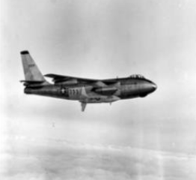

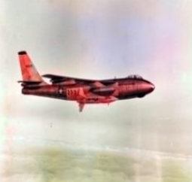
Project for the
Neural Networks Course
6 CFU
Graziano Specchi, Omar Bayoumi, Cristiano Bellucci

Slide 2

Introduction
1

Slide 3
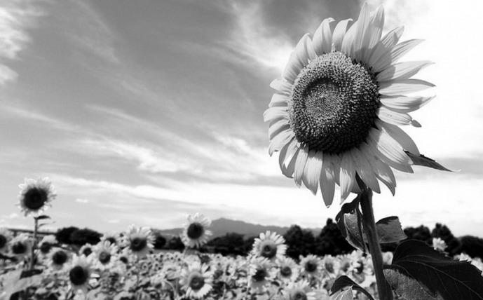
How much information does this image contains?
2

Slide 4
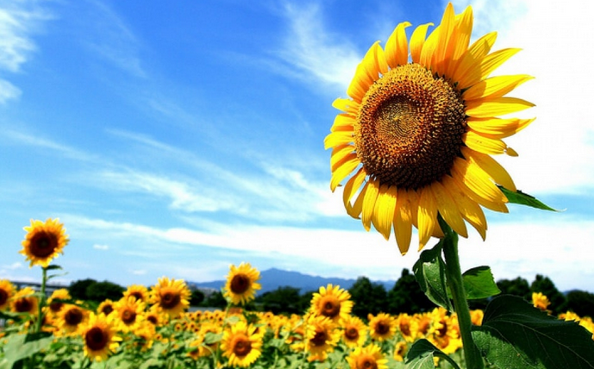
How much information does this image contains?
2
Our aim:
colorize the image in a way that
makes it realistic

Slide 5
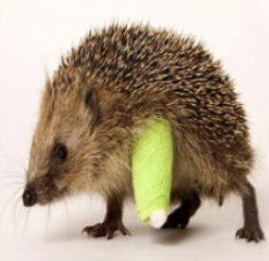
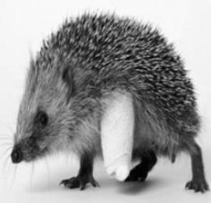
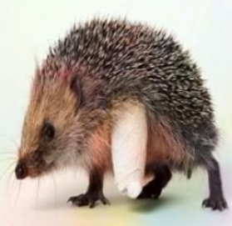
A key point:
3
Realistic doesn’t imply “as the original one”

Slide 6
A key point:
3
Realistic doesn’t imply “as the original one”

Slide 7
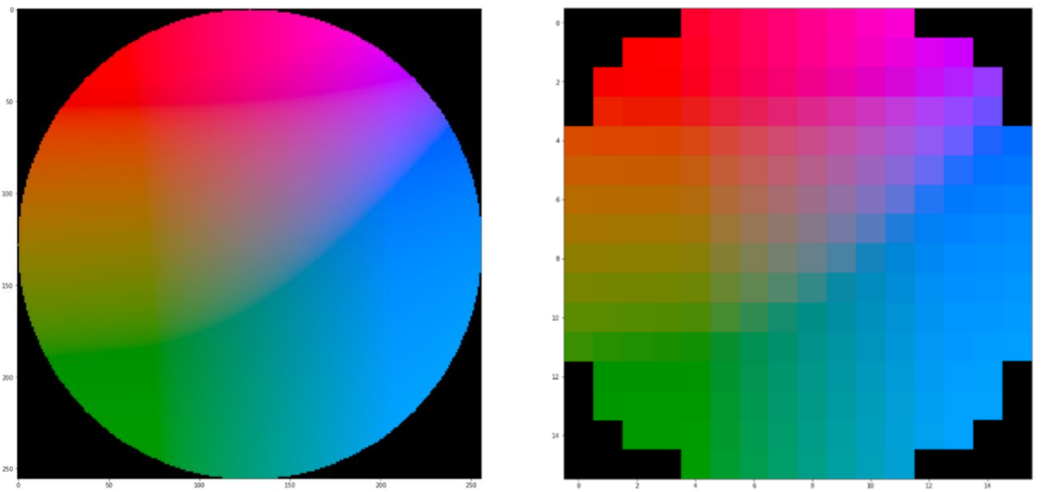
4
CIE LAB Color Space
What we actually used:
Lab Color Circle at L=50
224 Color Classes

Slide 8
4
CIE LAB Color Space
What we actually used:
Lab Color Circle at L=50
224 Color Classes
…but actually we dropped 110 classes that were not present in the training set.

Slide 9
Objective:
5
Train a model capable of colorizing grayscale images
L
ab + L
Model

Slide 10

Model
2

Slide 11
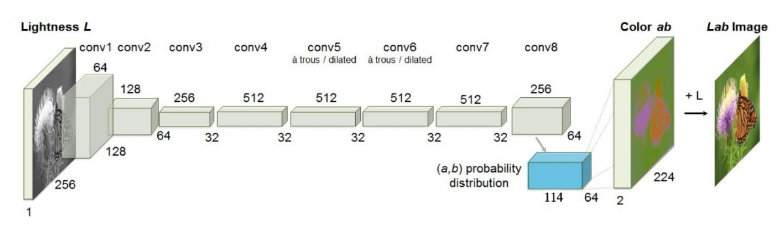
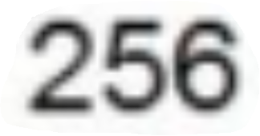
Model:
Pixel Classification
7

Slide 12

Dataset
3

Slide 13
Dataset:
ImageNet
9
Training
Validation
Testing
16 K images
3 K images
3 K colored images
3 K grayscale images
https://image-net.org/challenges/LSVRC/2015/2015-downloads.php

Slide 14

Training and Validation
4

Slide 15
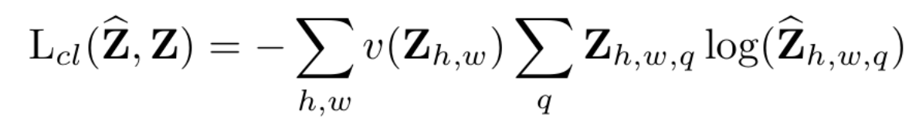
Loss Function
11
Weighted Multinomial Cross Entropy Loss

Slide 16
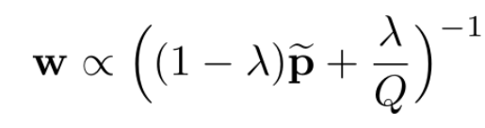
Loss Function
11
Weighted Multinomial Cross Entropy Loss
Smoothed Empirical Distribution P̃ mixed with Uniform Distribution
λ=0.5

Slide 17
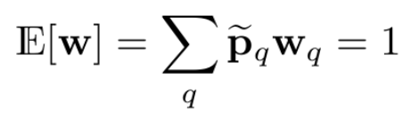
Loss Function
11
Weighted Multinomial Cross Entropy Loss
Smoothed Empirical Distribution P̃ mixed with Uniform Distribution
Normalization of w
λ=0.5

Slide 18
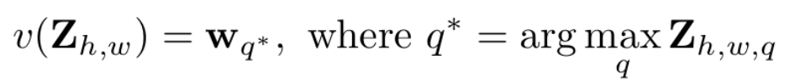
Loss Function
11
Weighted Multinomial Cross Entropy Loss
Smoothed Empirical Distribution P̃ mixed with Uniform Distribution
Normalization of w
λ=0.5
Final Weighting Factor

Slide 19
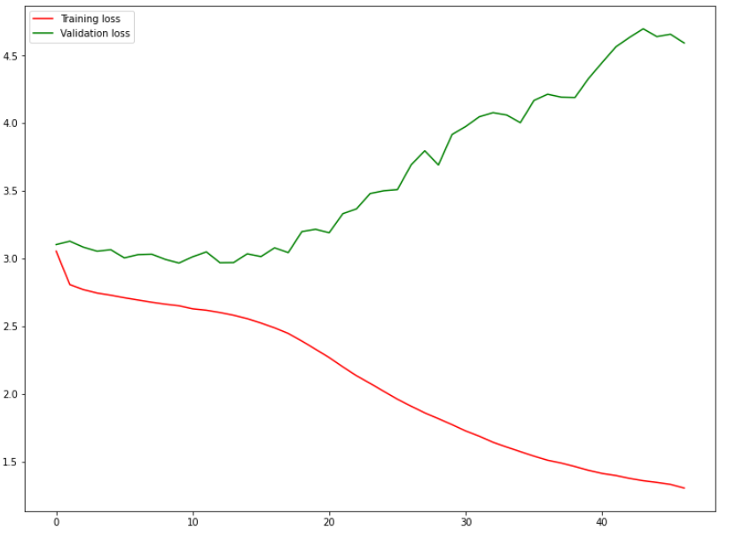
Loss Function:
Plot
12
Google Colab
72 hours
Early Stopping at epoch 13
Last Model at epoch 47

Slide 20

Image Colorization
3

Slide 21
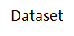
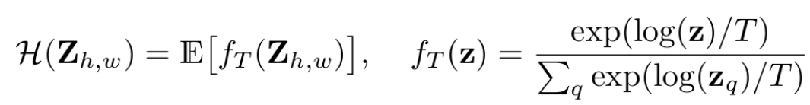
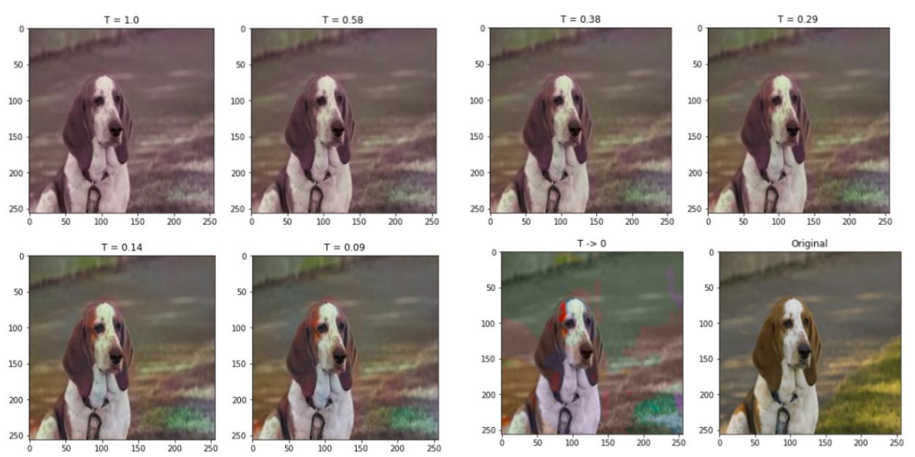
Simulated Annealing Inspiration
14

Slide 22


Tests and Results
5

Slide 23
Tests and Results
16
Two ways of testing:
Visual Evaluation
VGG-16
Watch the colorized
image and check if
it seems realistic.
Check if VGG-16 classifies correctly the colorized image.
Colorization
VGG-16
Porcupine

Slide 24
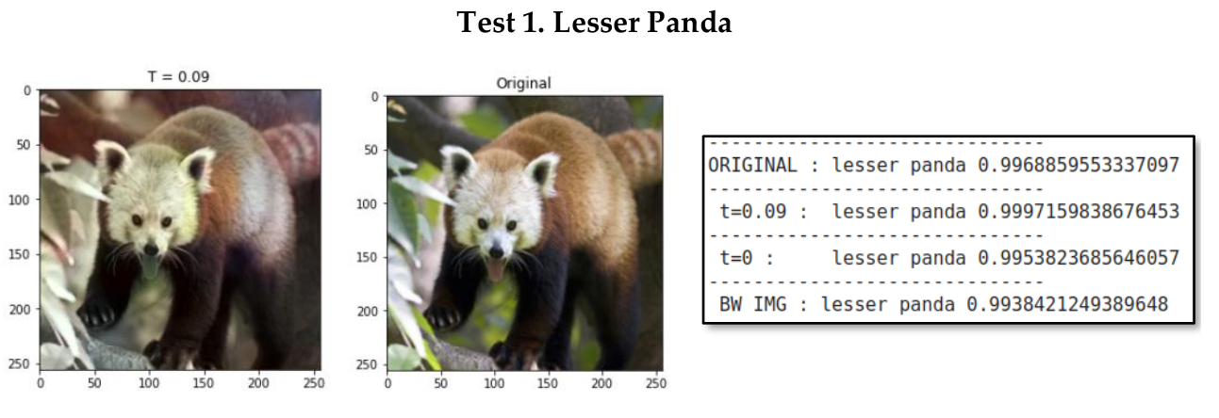
Tests and Results
17

Slide 25
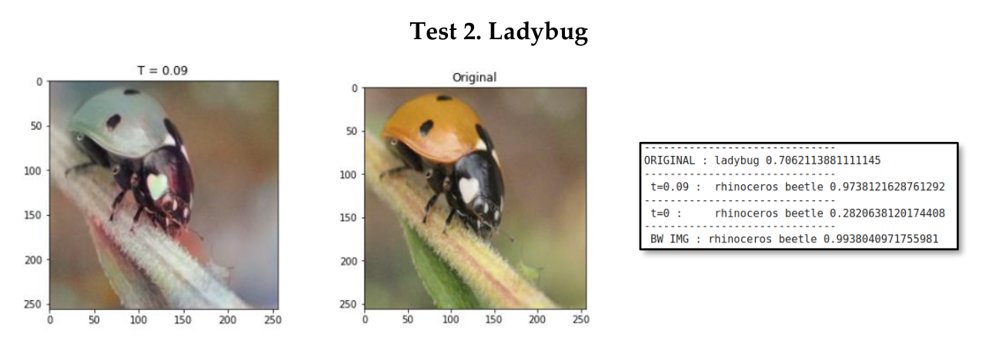
Tests and Results
18

Slide 26
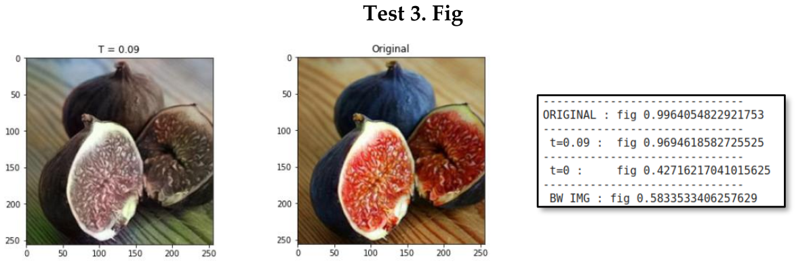
Tests and Results
19

Slide 27
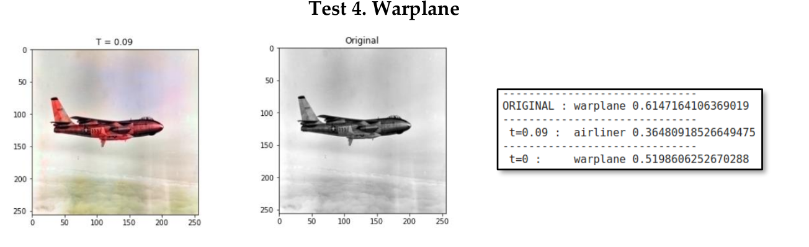
Tests and Results
20

Slide 28

Conclusions
6

Slide 29
Conclusions: Possible Improvements
22
Use larger datasets
Try other architectures
Train for more time
More memory and more GPUs
More classes in the Lab Space

Slide 30
References
23
Colorful Image Colorization
https://arxiv.org/pdf/1603.08511.pdf
ImageNet Dataset
https://image-net.org/challenges/LSVRC/2015/2015-downloads.php
CIE Lab Space
https://en.wikipedia.org/wiki/CIELAB_color_space
Project Code
https://colab.research.google.com/drive/1-MF_M5t8ZUVav3adi8q7aRNyqGAkvt94?authuser=1

Slide 31
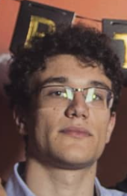

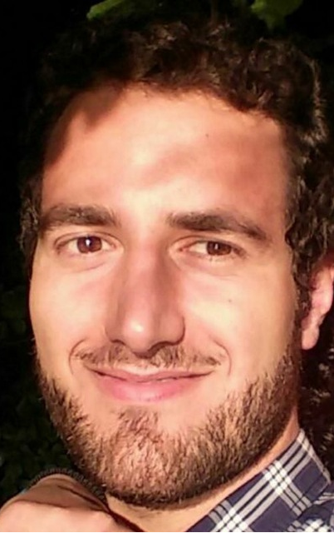
Thank you!
:)

